Slide 1
CP1 - Mobile network traffic prediction
Kishan Nagaraj

Slide 2
Use case
To use the traffic information available in Call Data Records (CDR) to deploy, configure and optimize network infrastructure.
To predict the location based (squared cell) next hour/day/week network traffic based on the measurement history of the network and current trend.
Implementation of Machine Learning based solution to the mobile network, in order to optimize and ensure energy efficient resources allocation.

Slide 3
Benefits
Dynamic Traffic Prediction and Planning mobile networks are challenging due to the high complexity of the telecom networks.
The Project is capable of extracting patterns and predicting network traffic from real world telecom data.
Traffic predictability and pattern extractions provide insights to design energy efficient schemes and to manage network resources optimally.

Slide 4
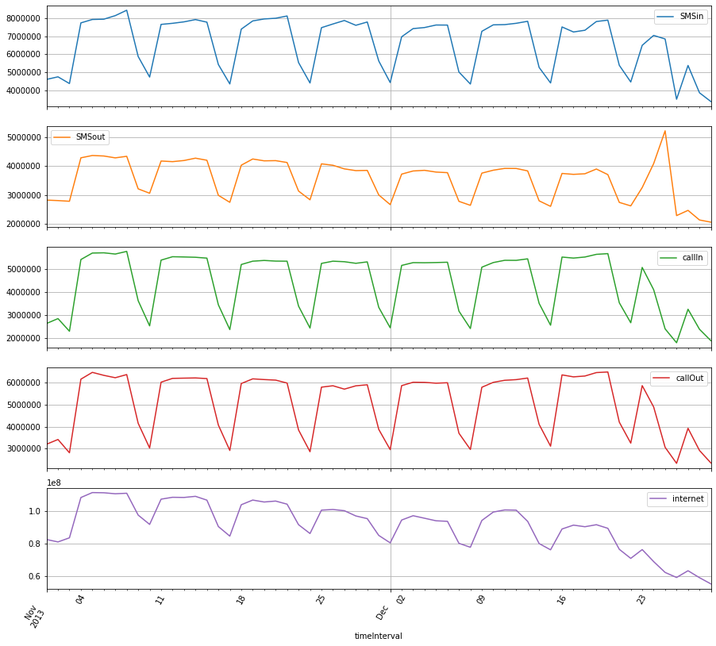
Pattern extraction
All telecom activities (SMS, calls, Internet) seem to follow a similar pattern with usage being relatively the same across the weekdays and a sharp fall during the weekends. The pattern is broken during the christmas period though
The pattern extracts the hourly insight of the data volume in the network and the same can be used for further prediction and resource allocation.
There are interesting insights extracted from this data. The Incoming and Outgoing calls are more in some specific range of Square Cells.

Slide 5
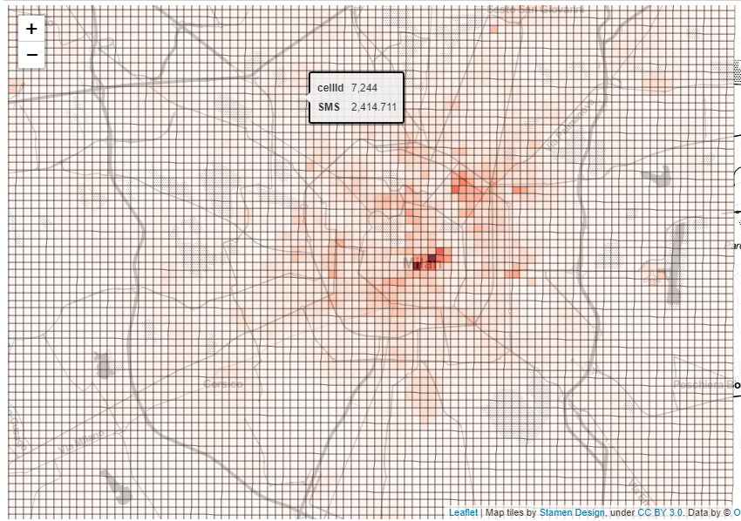
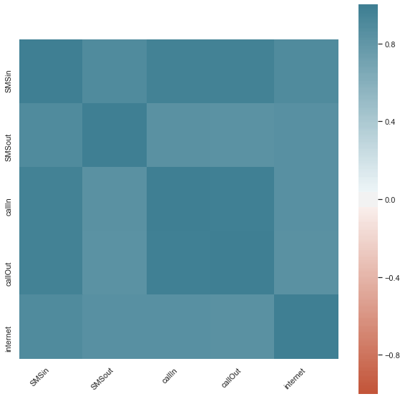
Pattern extraction
Grids concentrated in and around the city center have highest usage, whereas the usage is minimal in the outskirts. Usage per grid seems to gradually decrease as the distance of the grid from the city center increases.
The pattern extracts the hourly insight of the data volume in the network and the same can be used for further prediction and resource allocation.
Correlation matrix shows that SMS and Call are highly correlated

Slide 6
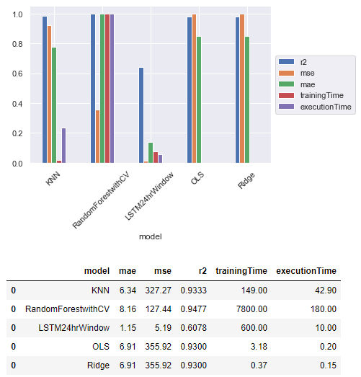
Model evaluation
Various Models were implemented for autoregressive data (time series) and correlated variables
Problem with the time series approach is that the data becomes very limited as we have to consider the time series evaluation only on a per cell basis.
For our scenario, out of all the evaluated models, KNN showed the best performance both with respect to training and execution time.
KNN model has r2 score close to 94%

Slide 7
Next steps
The Project is ready for Dynamic Traffic Prediction using real life big data - open datasets provided by Telecom Italia.
Further extension can be planned to incorporate social impact and trend analysis in traffic planning, topology based influence, deviation detection to be used for fault recognition, self-healing, anomaly and attack detection.
Developing Machine Learning based system to address demand prediction and provisioning allowing the network to resize using virtualization and addressing network resilience issues including identifying network errors, faults or conditions such as congestion or performance degradation.
Can be incorporated with existing telecom products for network analytics, network optimization, traffic prediction, security, planning, fault management etc.
The dataset considered is only for 2 months, if we have at least a year’s data then annual seasonality and trends can be used to get better predictions.

